Slide 1
COPD Canada Member Survey
This COPD Canada survey sought to answer the following question:
Have things changed for Canadian COPD patients because of the COVID-19 pandemic and if so, how?
Note: The survey was emailed to members of COPD Canada on February 1, 2023. Members were asked to complete the survey before the end of February 2023 for publication in March 2023. The identity of survey participants was not collected.

Slide 2
COPD Canada – Members only

Slide 3
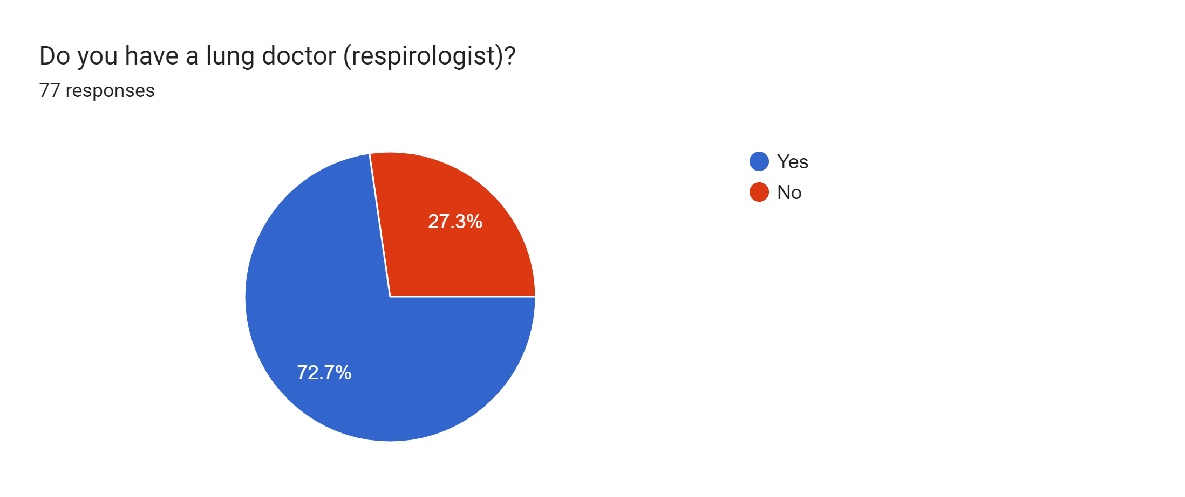

Slide 4
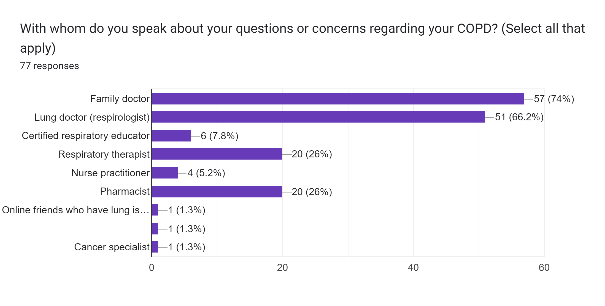

Slide 5
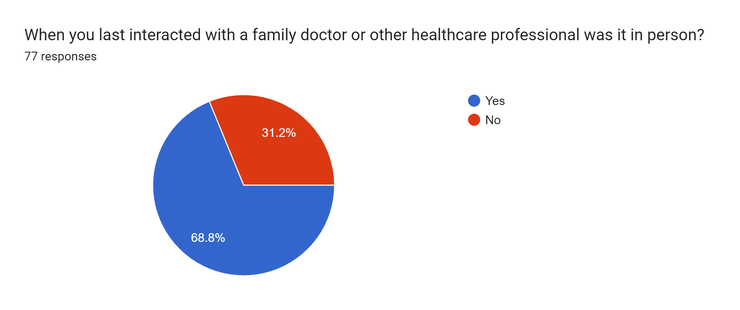

Slide 6
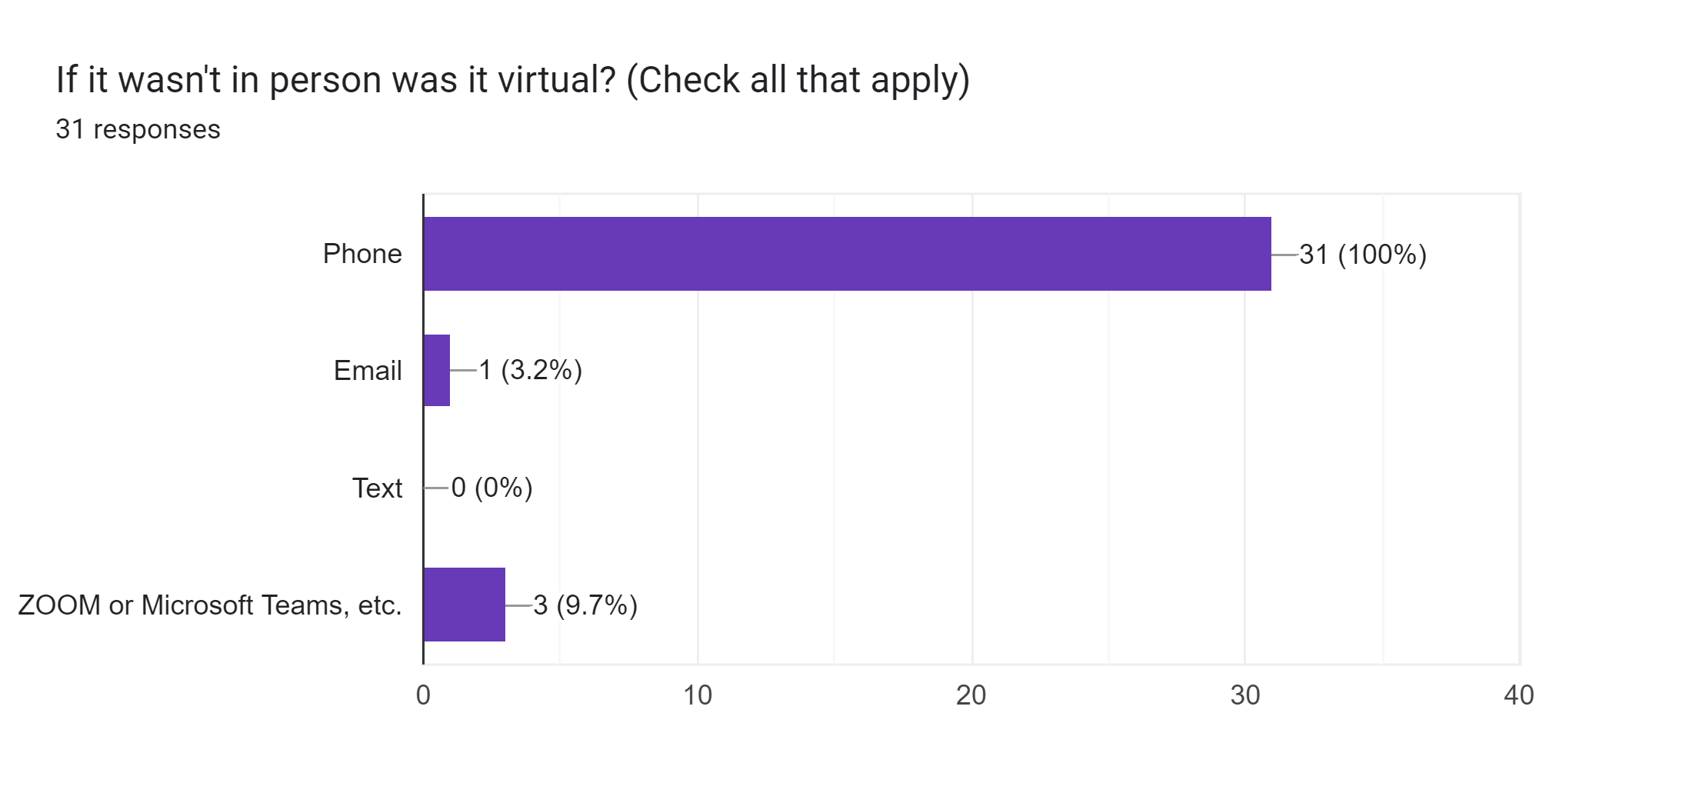

Slide 7
When did you last interact with a respirologist?
January 2023
December 2022
October 2022
November 2022
2 years ago
2019
December but one that was filling in for mine
Dec. 30, 2021
Jan.30'23
Two months ago
Jan 2018
11 years
don't have one
Spring 2022
6 yrs
Two months ago in dec 2022
October 21, 2022
2 years ago they don't make house calls and don't take
phone calls
July 2022
3 years
About four to six months ago
phone calls
July 2022
3 years
About four to six months ago.
November 2016
while in hospital 2 yrs ago
A year ago. Will see him again soon
never
2022
December
6 months ago
January 18, 2023
I don't remember
Nov 14/22
3 months
Approx. 5 months ago.
Last February
January 21, 2023
have an appointment on February 16th, 2023 in person
3 yrs
April 2022
November 2023
A month ago

Slide 9
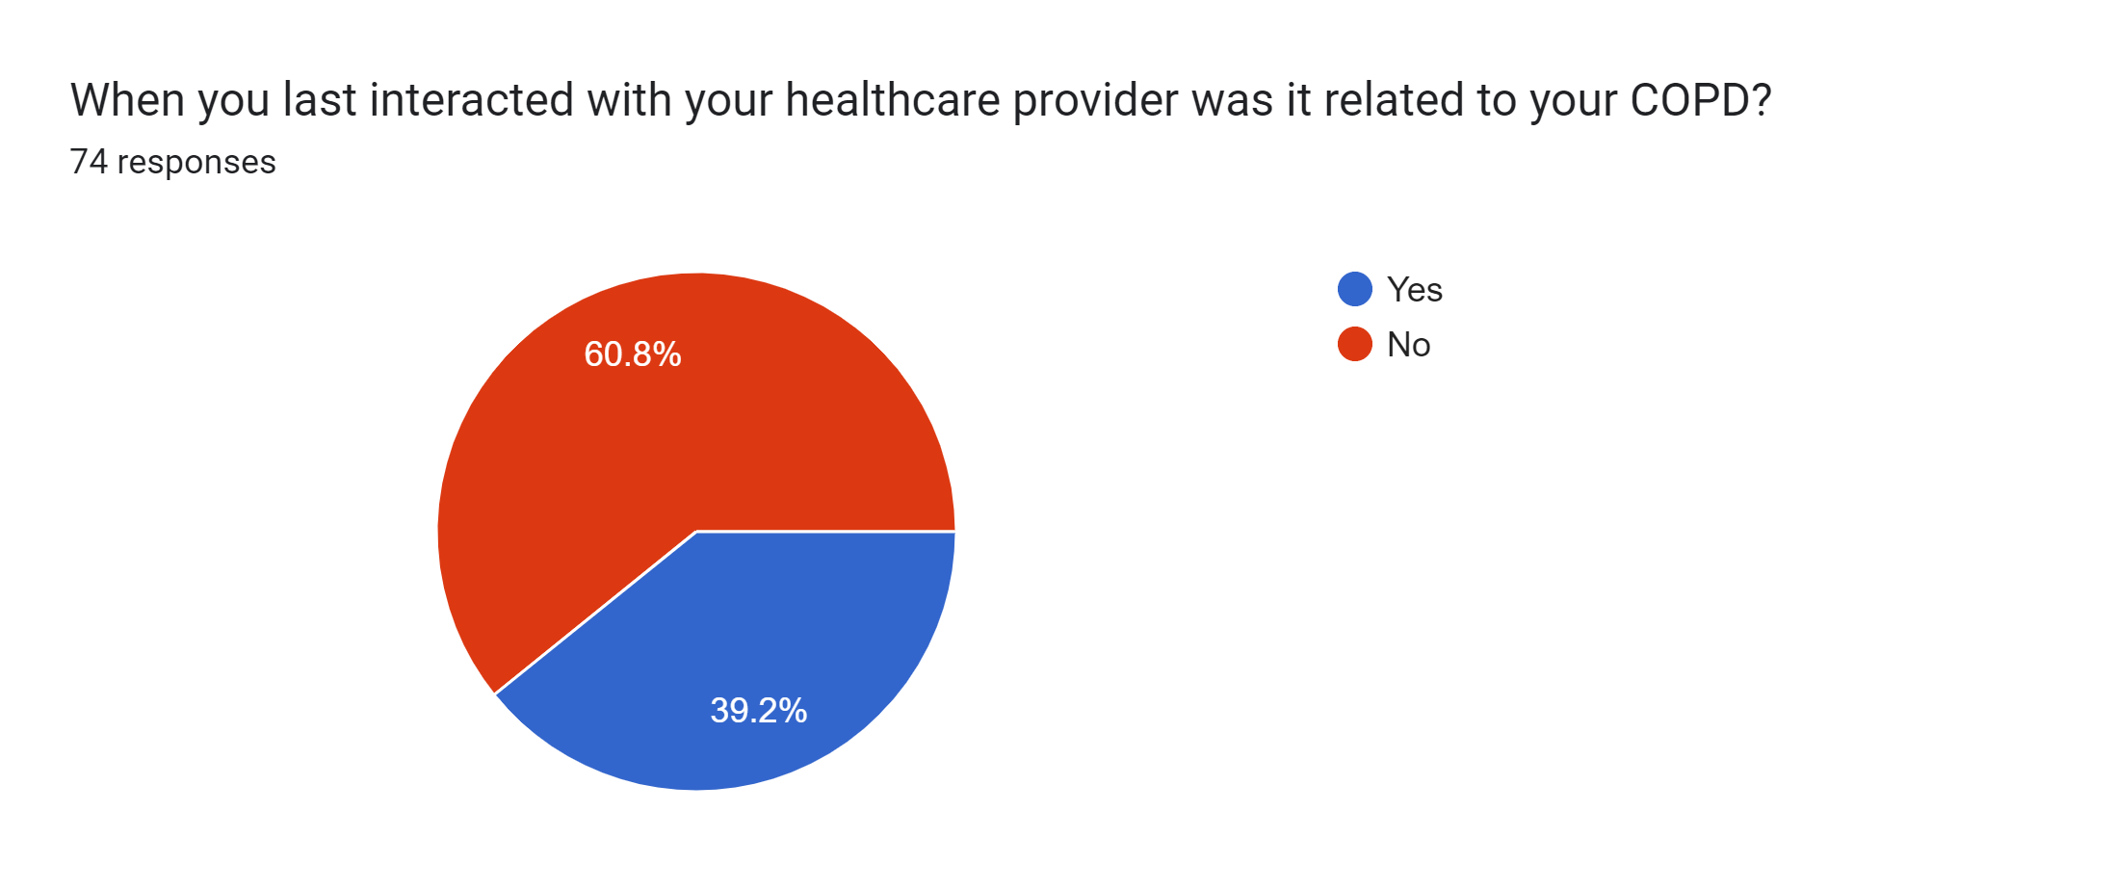

Slide 10
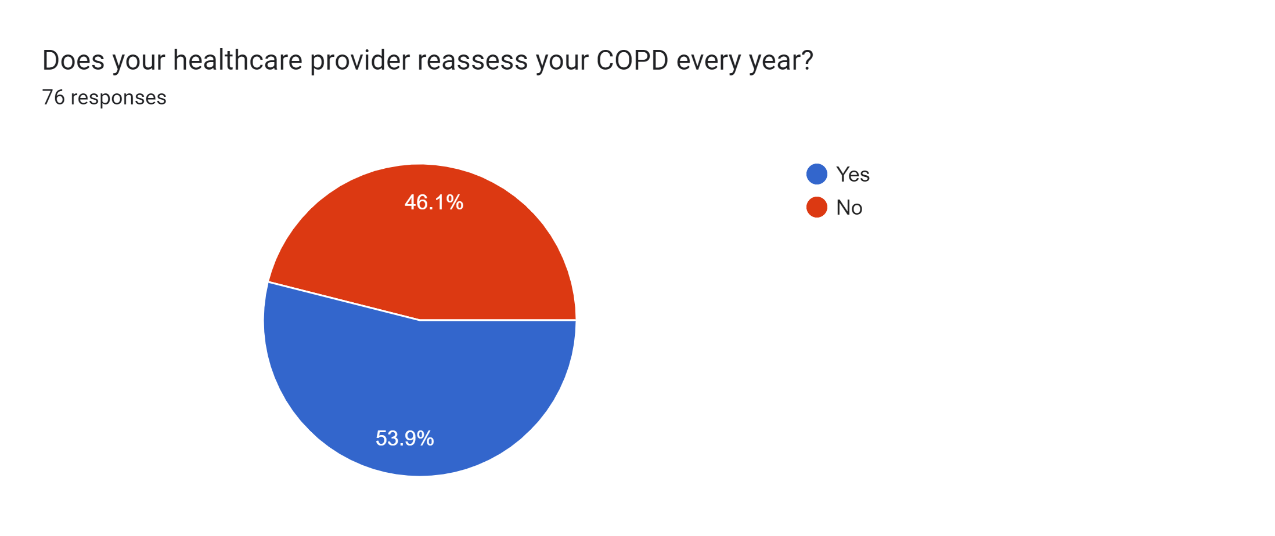

Slide 11
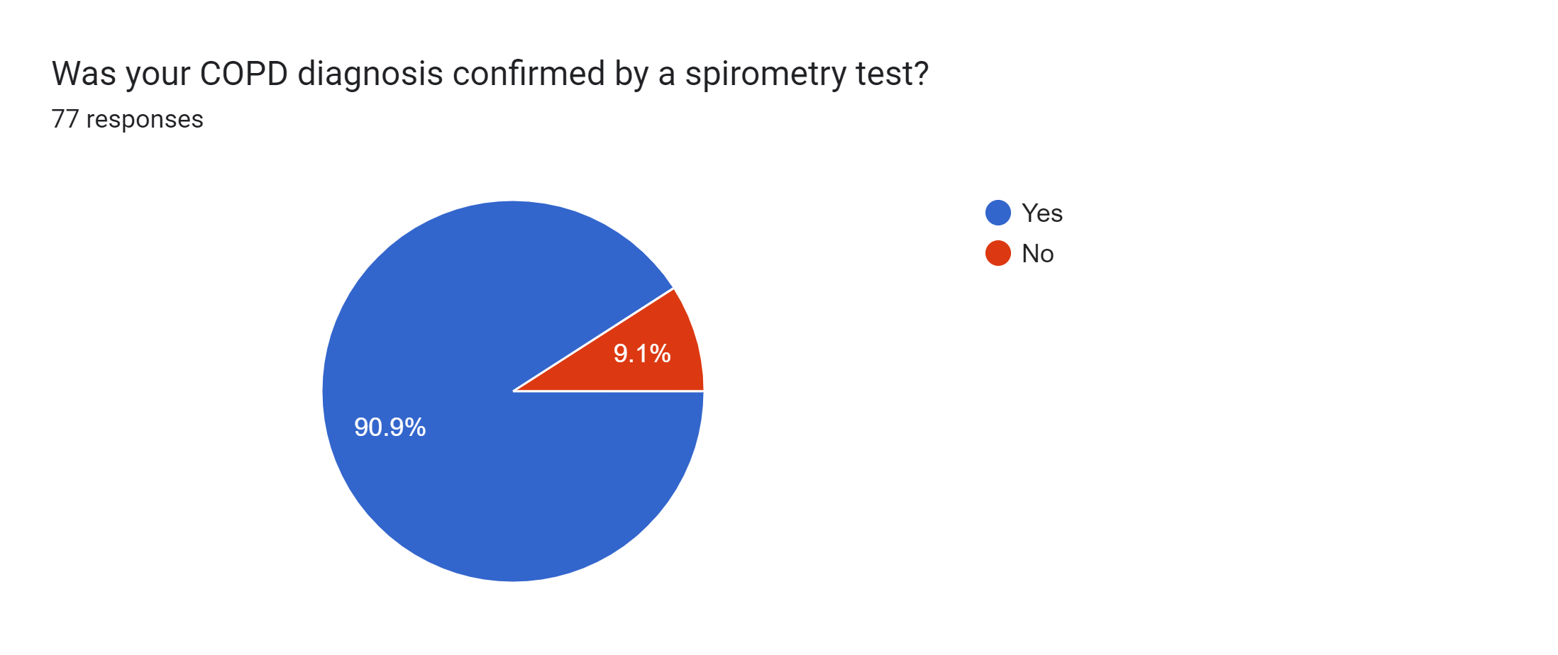

Slide 12
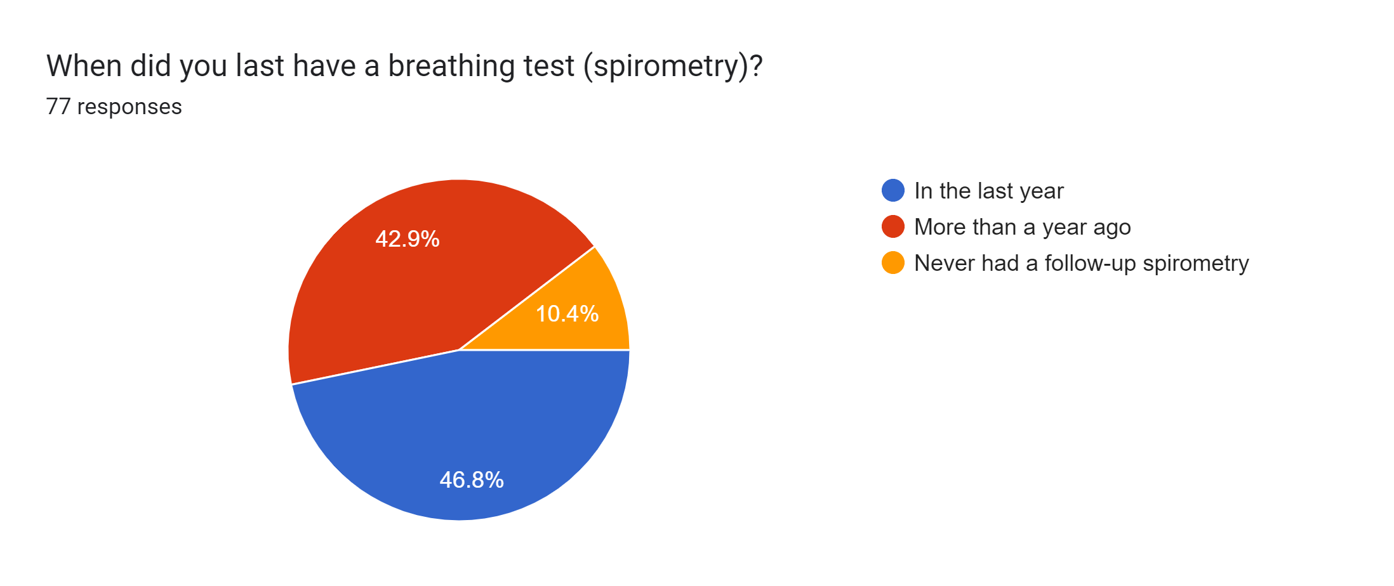

Slide 13
Impacts of the COVID-19 pandemic

Slide 14
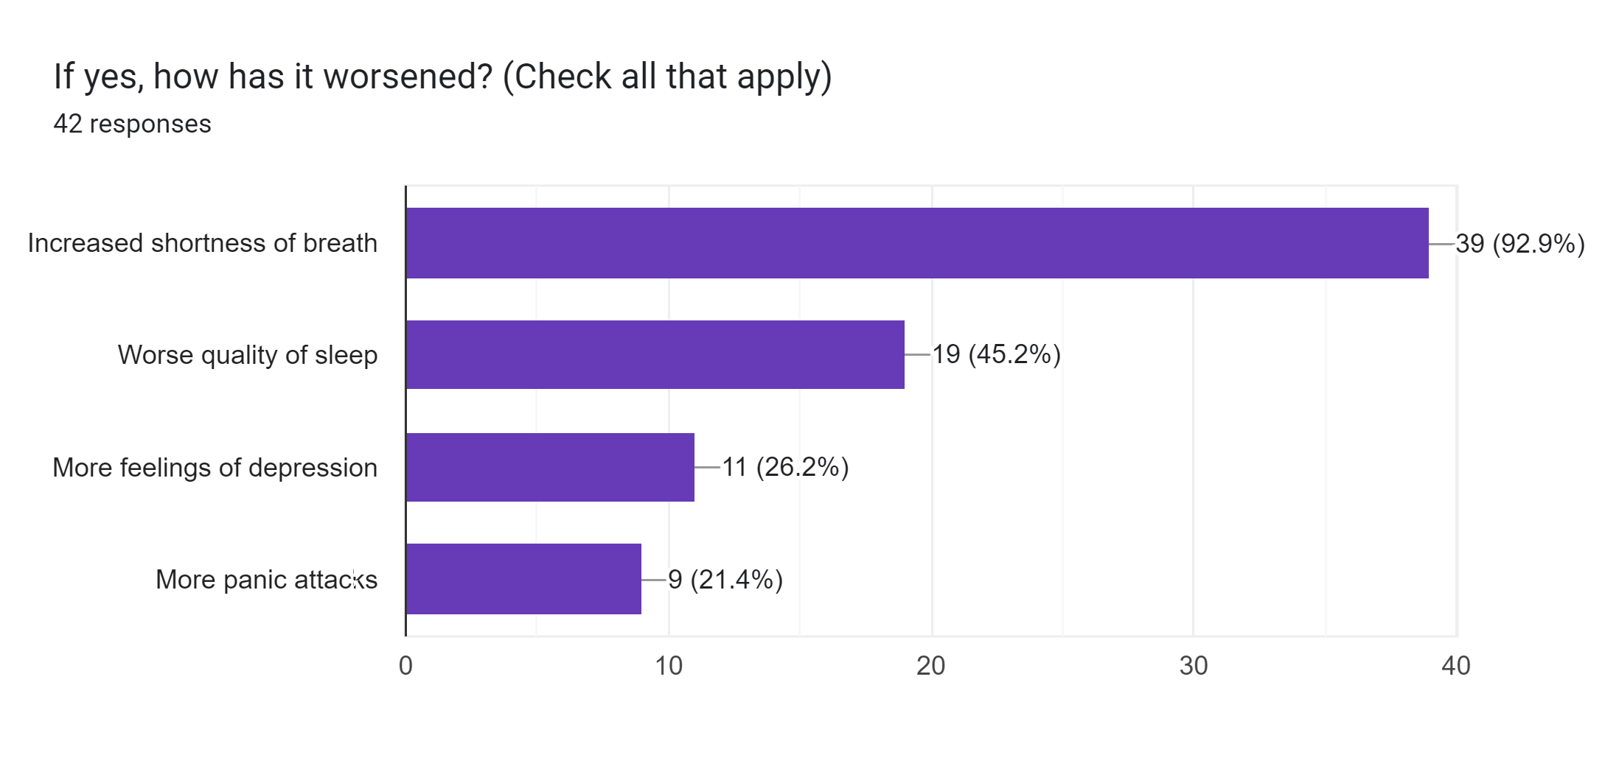

Slide 15
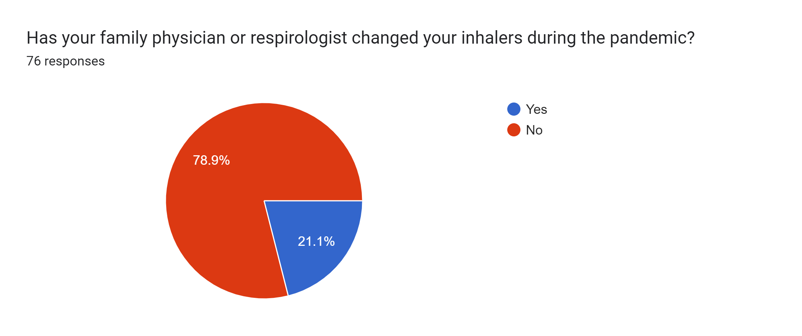

Slide 16
If yes, what was the change? 17 responses
Symbicort 200
Insploto Respimat
at the hospital they changed my puffer to
Trelegy Ellipta
New inhaler
Added Trilogy, d/c Tudorza and Advair
from breo ellipta to trelegy ellipta
instead of 2 morning buffers I now take only
"1 a day" all meds included in the one
To Trelegy and back to Advair
changed to BREZTRI
Changed Advair to a mist
changed spiriva to Respimat
None
Started on Brio
Changed puffer
increased shortness of breath
n/a
Went from a powder to a mist
from 2 "a day" to just one a day + of course still have emergency puffer

Slide 17
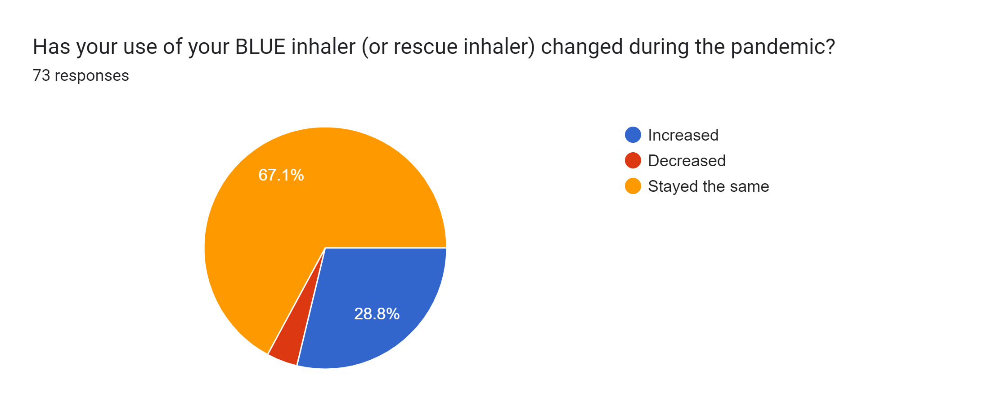

Slide 18
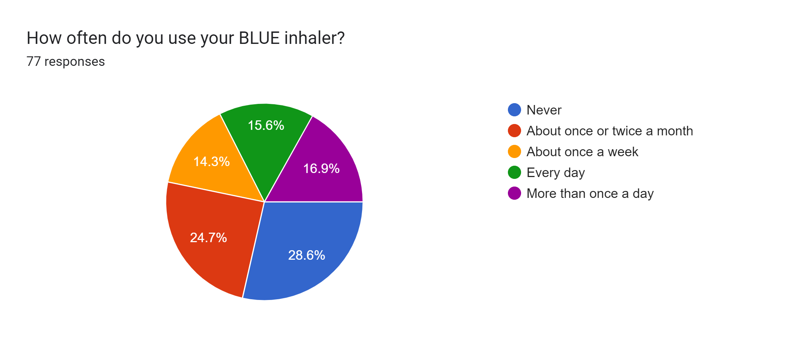

Slide 19
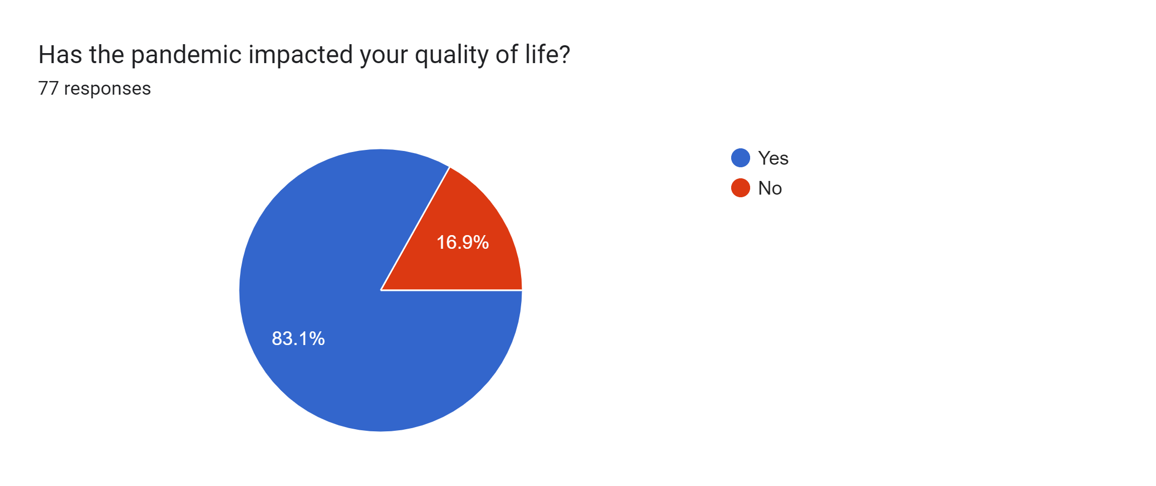

Slide 20
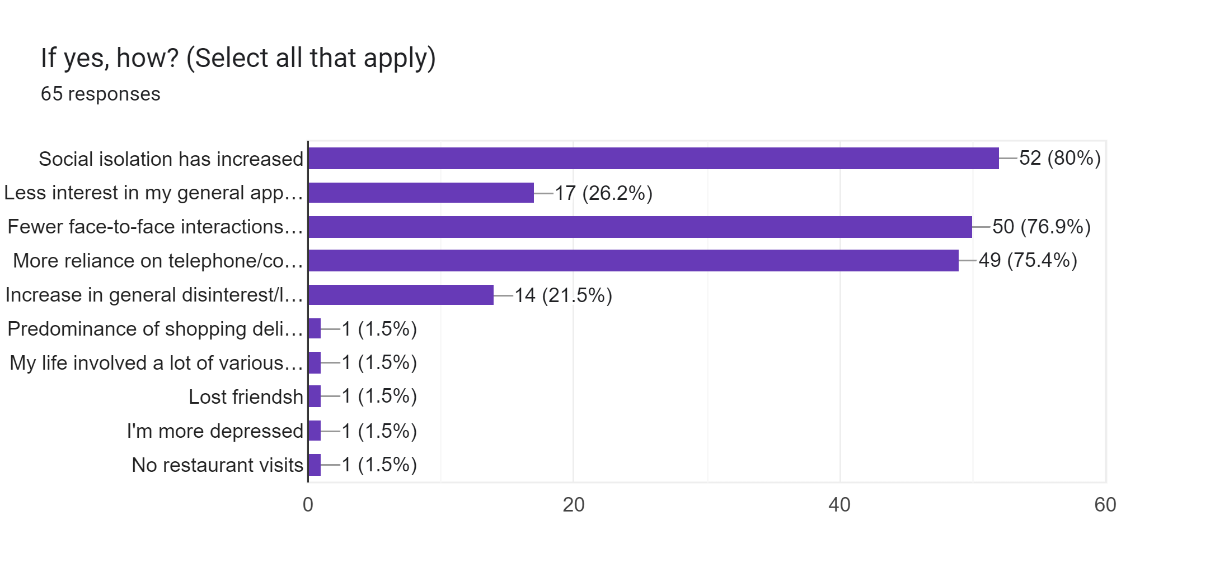

Slide 21
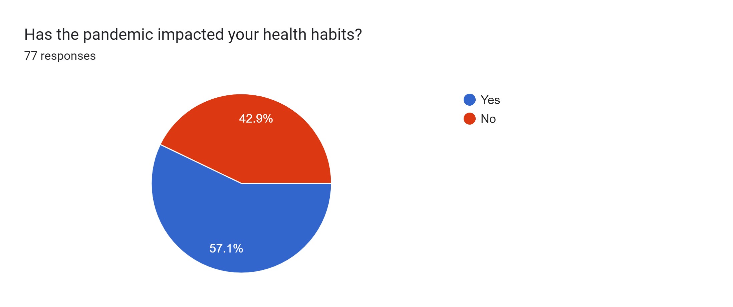

Slide 22
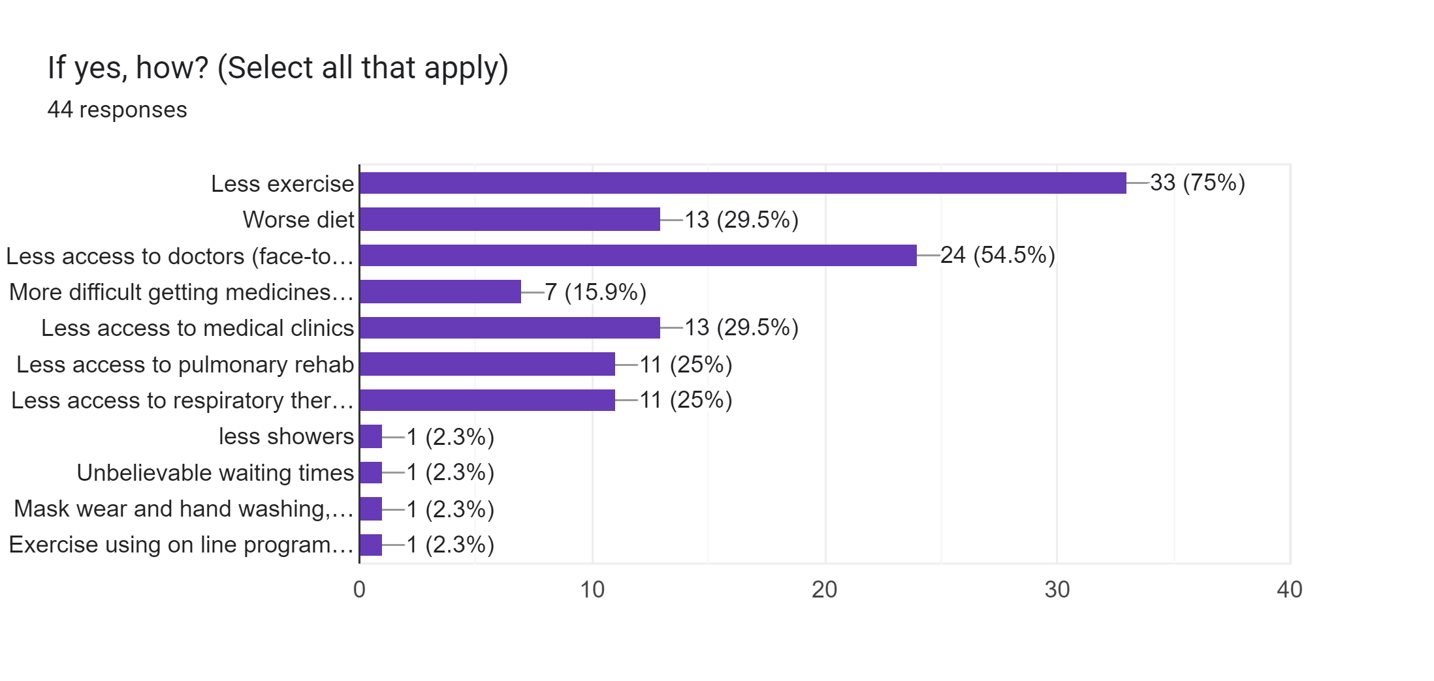

Slide 24
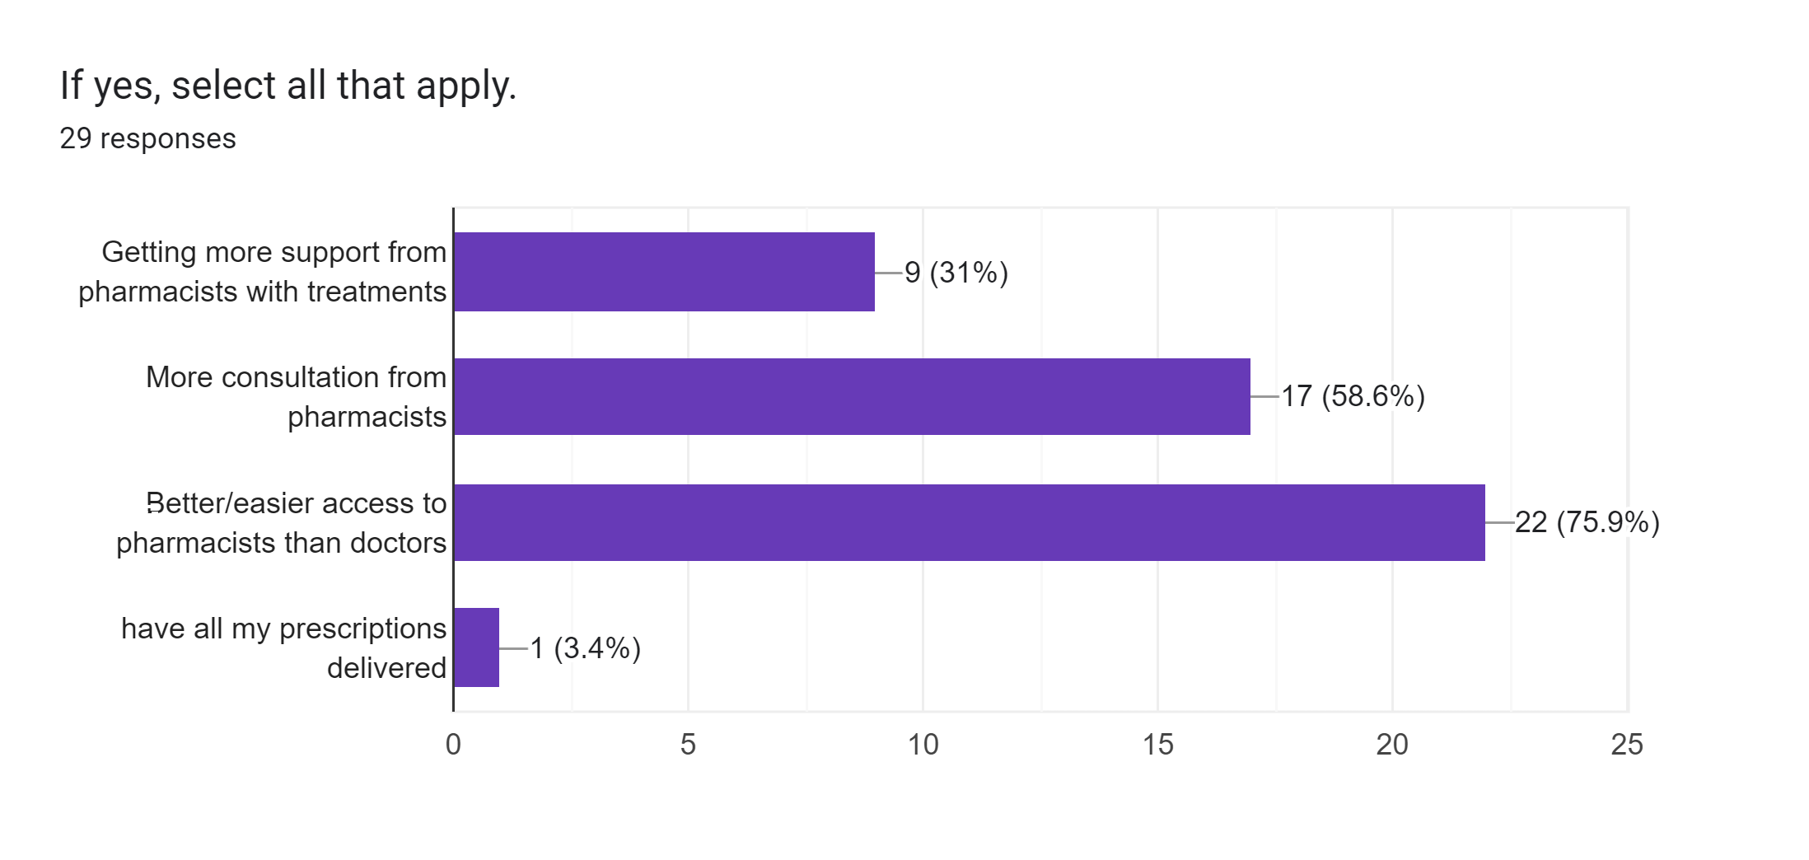

Slide 25
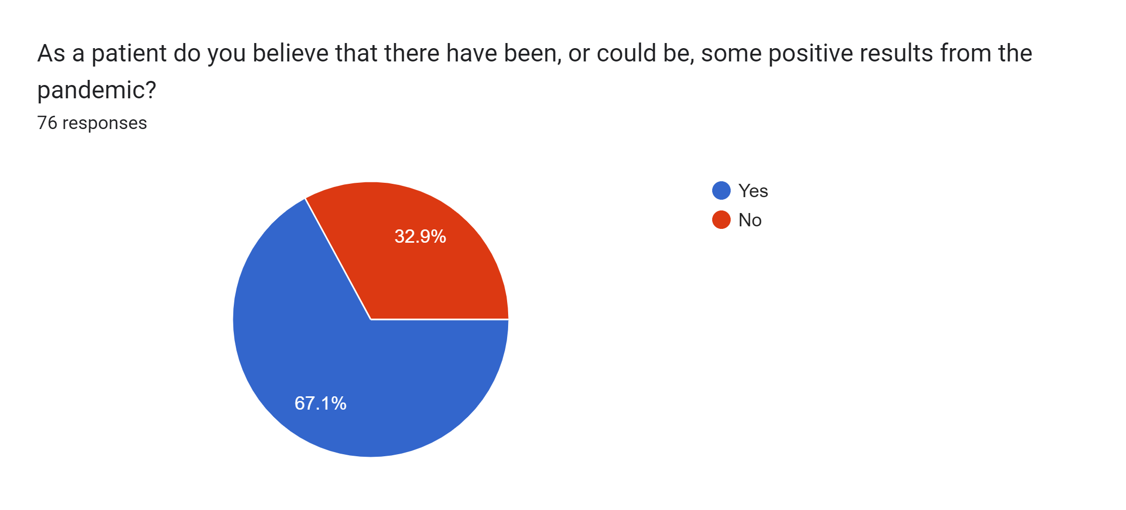

Slide 26
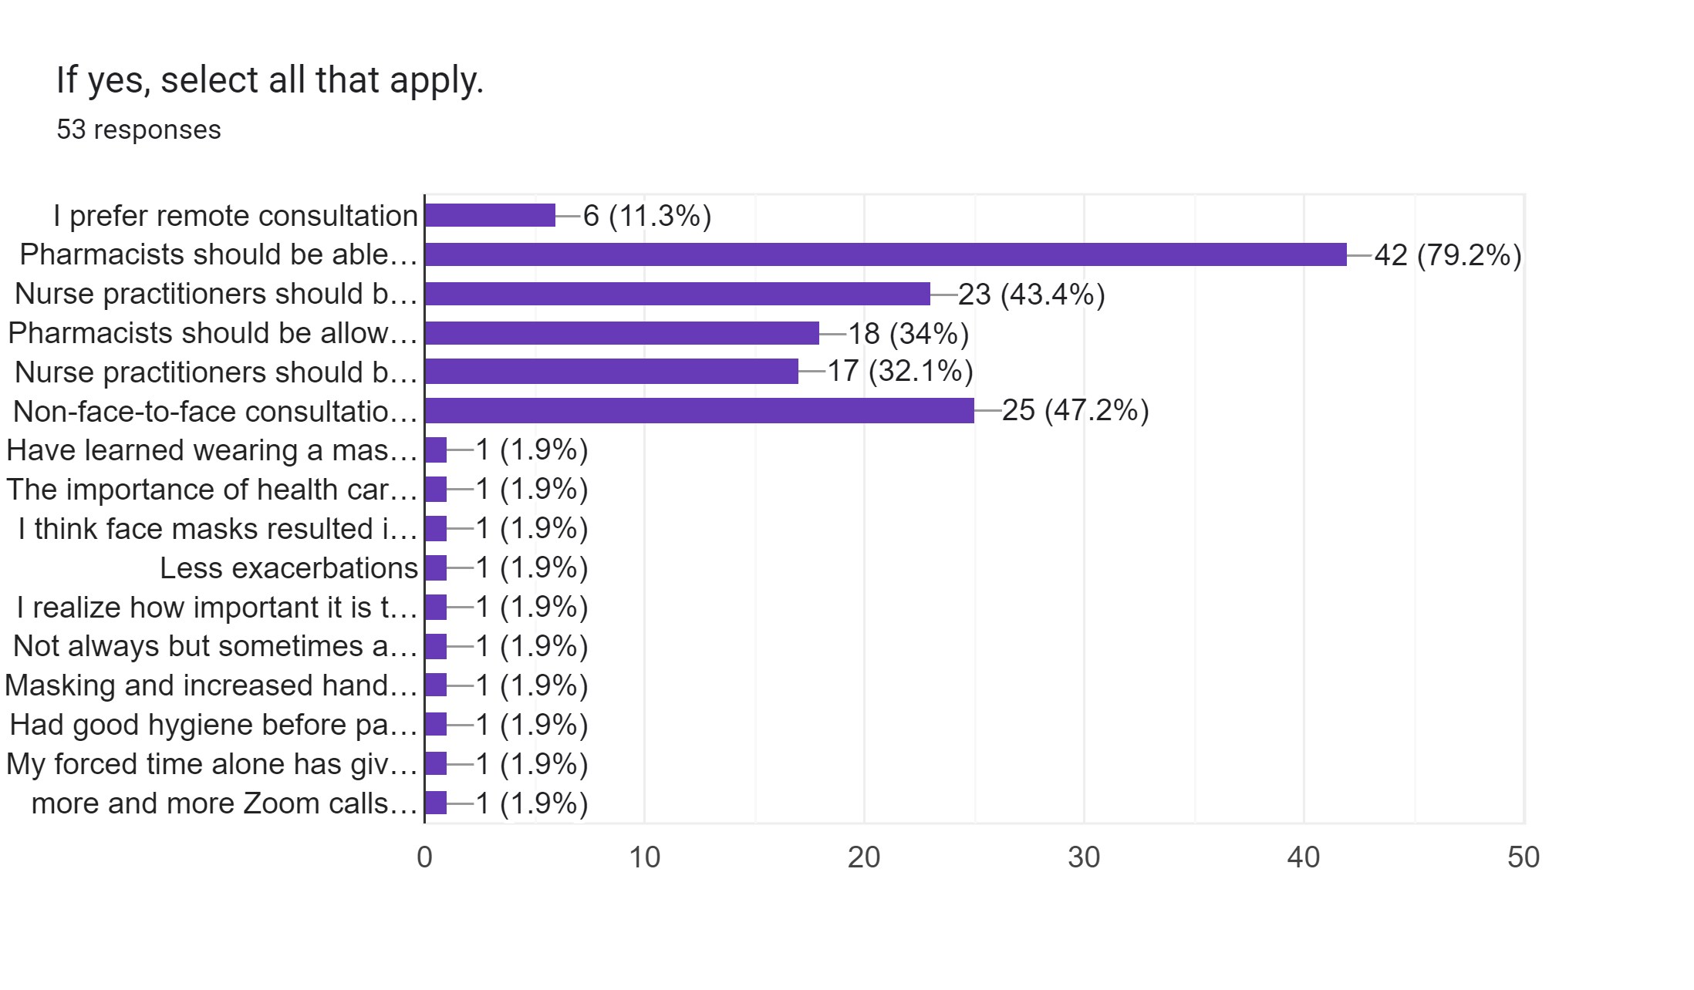

Slide 27
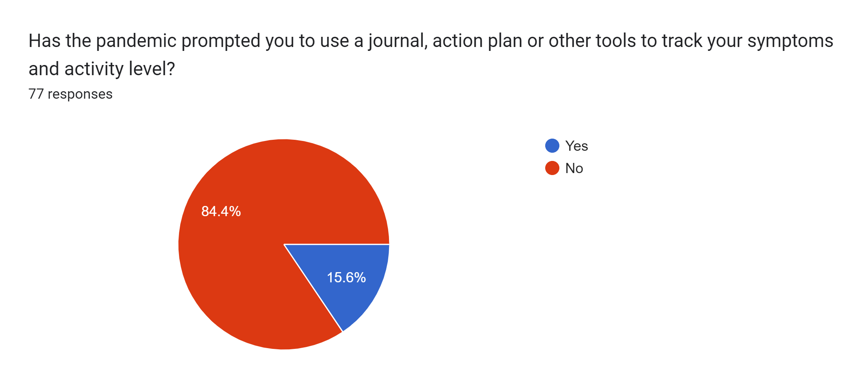

Slide 28
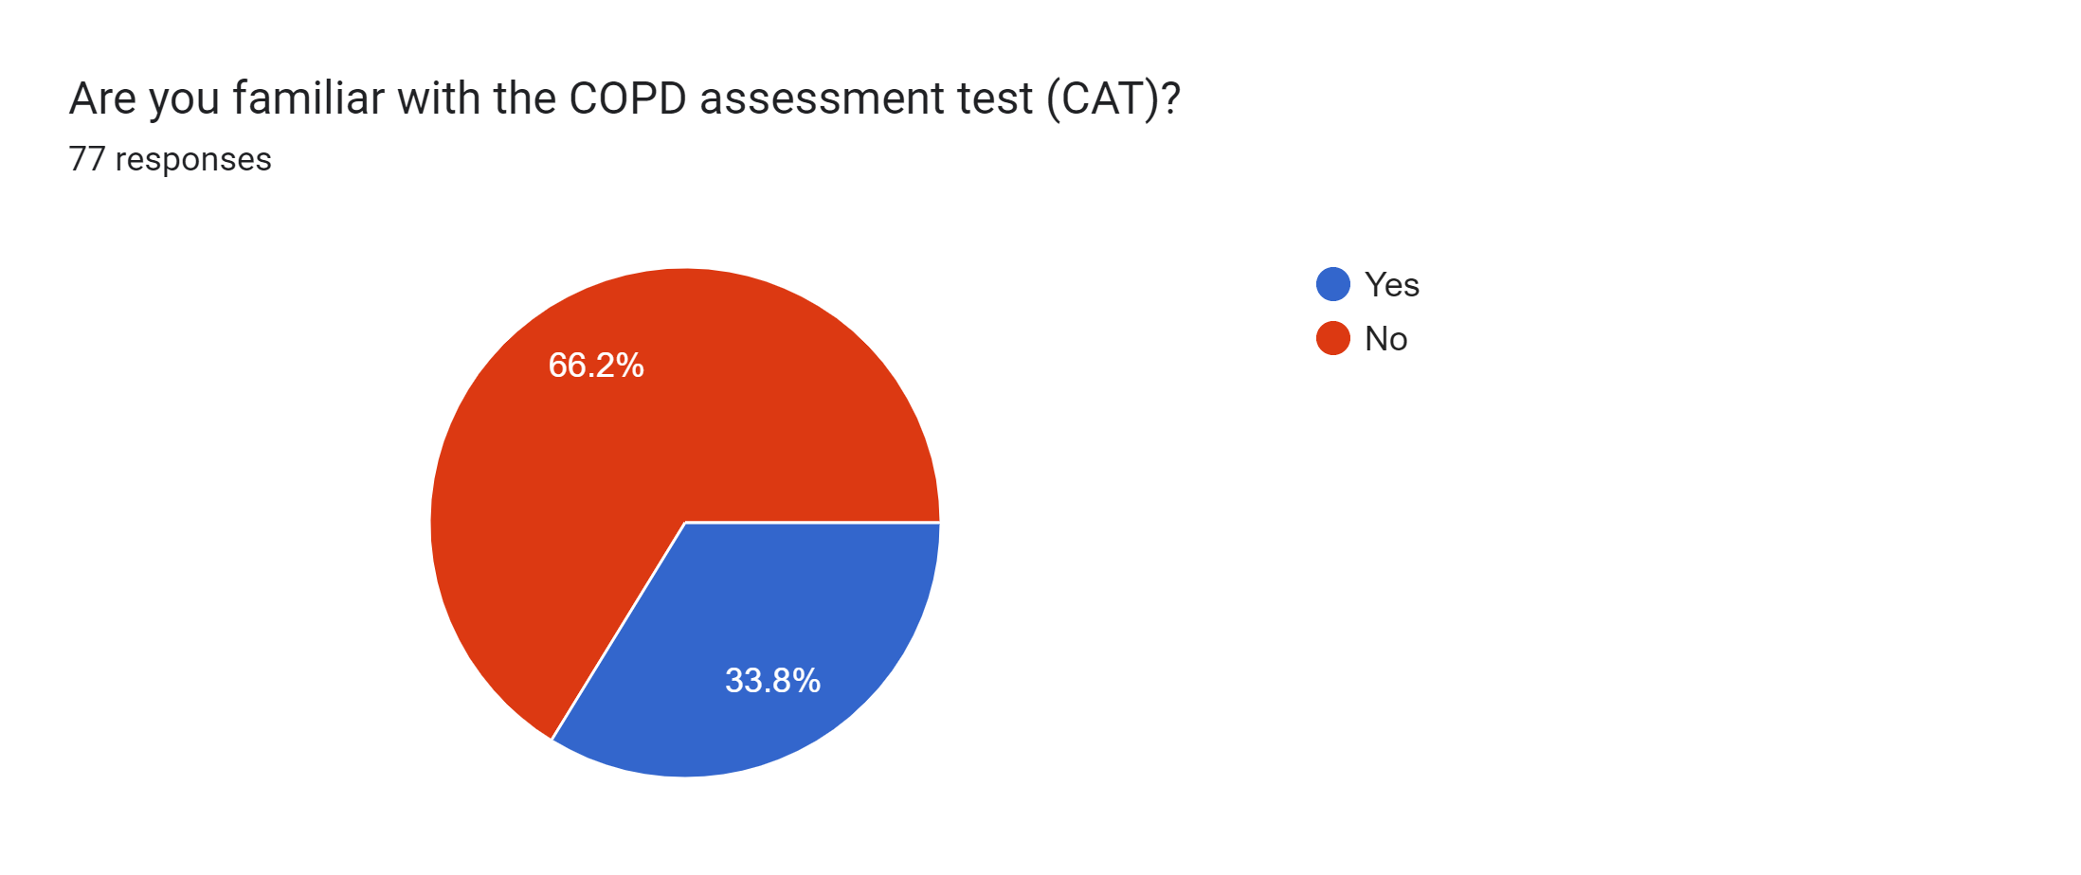

Slide 29
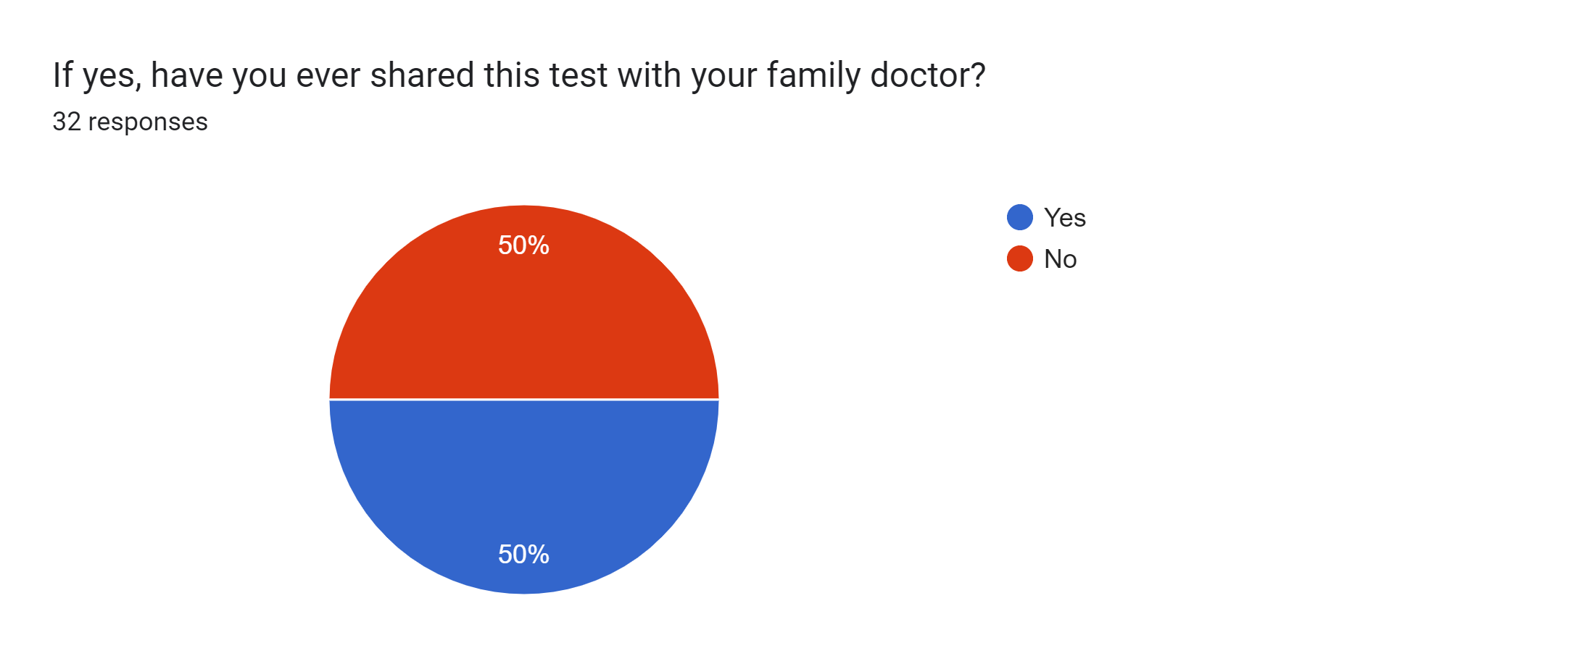

Slide 31
If yes, what type of concerns do you have? 34 responses
I have asthma copd overlap and because of flares my exertion and exercise tolerance is down or I suffer when I do too much.
Fear of covid itself & long lasting effects
Lack of care by my doctor. Not being able to contact doctors. Limited availability to get in touch with the doctor.
Need for more exercise. What level is my COPD at as I get winded quicker with more exercise.
less exercise (just sitting around) due to staying at home has all kinds of consequences
afraid to gather with entire family at the same time for fear of contacting a cold/flu, etc.
I have developed hardening of my lungs after having COVID in Jan 2022
Access to treatment
they don't give a dame, they think you will die soon, so why bother
more carful around other people
Less support for copd.
The inability to get a good uninterrupted night’s sleep.
more careful being near people. Risk of any infection.
intubation
COPD affects the lungs thus my concern about new lung damage has increased.
SOB has become worse
concerned about progression
At increased danger of serious consequences from COVID infection
Catching colds, flu, covid
Increased vulnerability to Covid
worried about contracting Covid or other airborne infections
No exercise, less access to doctors, fear of exacerbations and having to go to overcrowded hospital
Worried about less contact with doctors, RTs and no pulmonary rehab. No contact with other people with COPD, to share experiences, notes, tips, etc.
Breathing and lack of exercise getting worse
not to catch a cold flu etc
Low energy and strength and increased breathlessness.
More use of the inhaler
If I get covid will I die a nasty death
Not being able to go outdoors or anywhere without wearing a mask. As a COPD patient I am very much aware of the dangers should I get Covid.

Slide 32
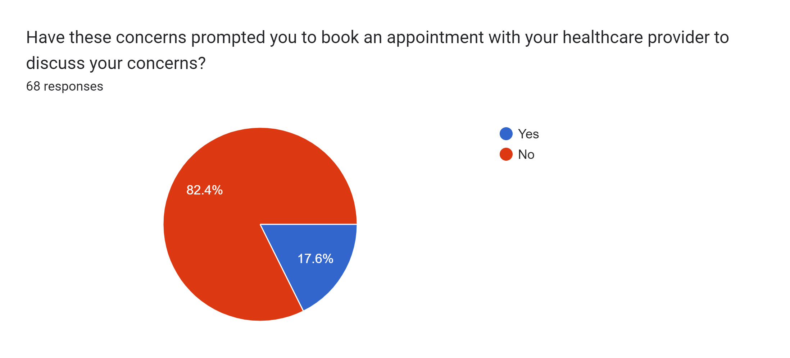

Slide 33
Demographics

Slide 34
Where do you live? Please indicate city and province. 77 responses
Brampton Ontario
Toronto
Charlottetown PEI
Toronto, Ontario
Vernon, BC
Markham Ontario
Newcastle, ON
SW Calgary AB
Burlington On
Hamilton Ontario
Brandon , Manitoba
St John's NL
Wasaga Beach, On.
Sudbury Ontario
Oakville, ON
Courtenay, British Columbia
Delta British Columbia
Tottenham, Ontario
Hagensborg BC
Pickering Ontario
Chatham Ontario
Edmonton Alberta
St Catharines Ontario
Burnaby, B.C.
Cornwall O
Langley BC
Calgary Alberta
Courtenay BC
Vancouver, BC
Sherwood Park, AB
Charlottetown, PEI
Victoria
Ontario
London Ontario
Toronto On
Toronto ON
Carleton Place
Otter Lake, Quebec
Angus , Ontario
Weymouth Nova Scotia
St. John’s NL
Utopia, Ontario
Ottawa' Ontario
Gravenhurst ,Ontario
Toronto Ontario
Manitoba
Ste-Anne des Lacs Quebec
Sarnia, Ontario
Collingwood, Ontario
Calgary, Alberta
Edmonton, Alberta
Woodstock Ontario
Prince George BC
Toronto Ontario
Cobourg Ontario
Toronto Ontario
Nelson BC
Binbrook Ontario

Slide 35
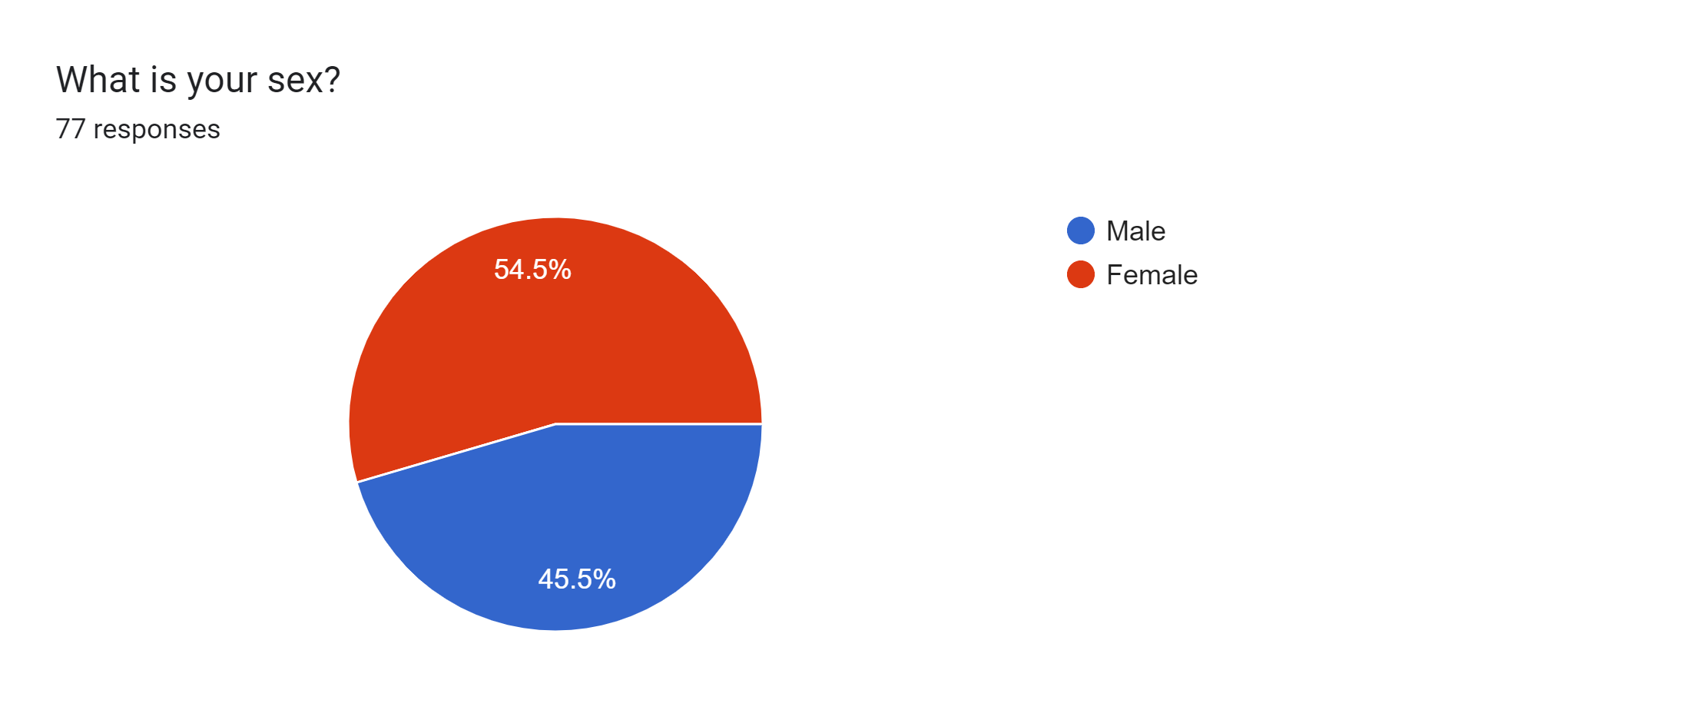

Slide 36
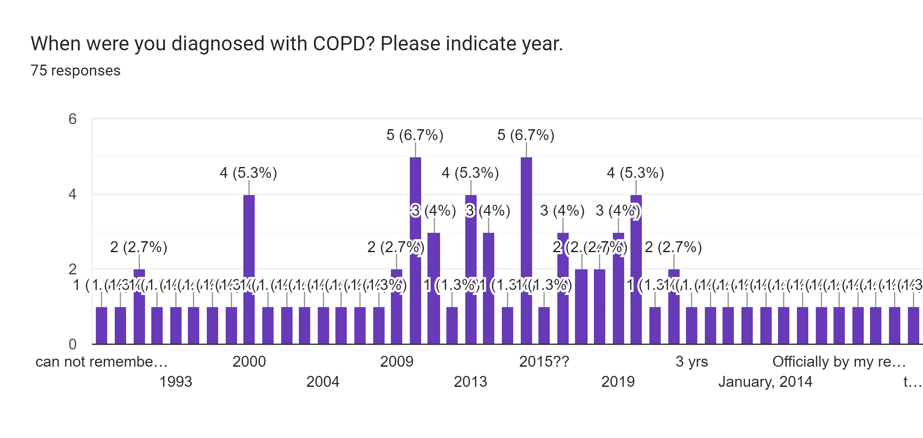

Slide 37
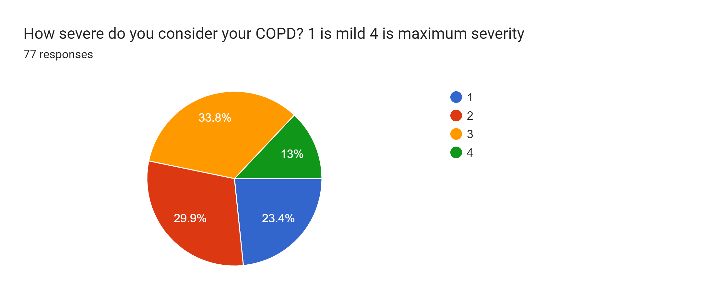

Slide 38
Immunization - Vaccination

Slide 39
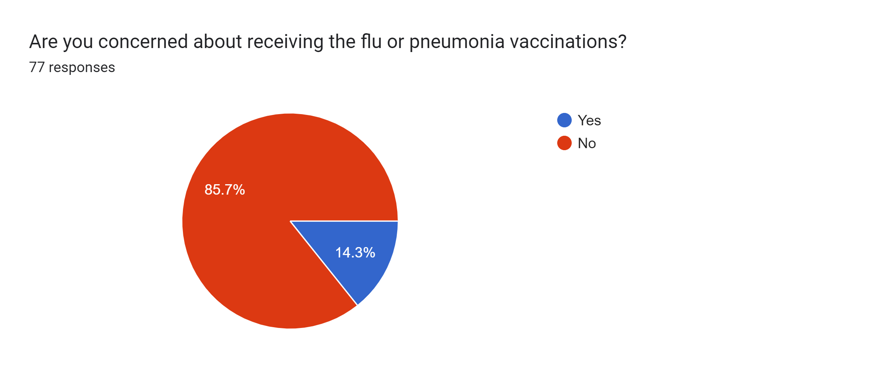

Slide 40
If yes to either of the questions above, what is your concern? 15 responses
Side affects
Blood clots
want to get it
getting them at home
Every time I took a flu shot I ended up sick with symptoms that the shot was to prevent
Injury from the mRNA vaccine itself
Long term effects of covid vaccine
Getting them
how is it going to affect me and my medical issues
I sincerely believe covid vaccine is poison; never used or will use the other
Will they help or hinder
I was unable to walk with the second dose of Pfizer Vaccine It costed me $17,000.00 to walk again and lost my speed till the present, still I am with Therapists for maintenance. My diagnosis is Multi chemical, food allergies and sensitivities for the last 30 years. All my problems began since I was 7 years old due the real "vaccines", that I was given at once. Till then I was the happiest and healthiest girl, no vaccines at all in the little town I was born in South America, Bolivia.
Unproven safety and efficacy
My concern is with the flu vaccine, when it is 98% positive I will consider it! Every 10 years I receive the pheumococcol vacine, I am due for another injection 2026!
Availability and cost for the "High Dose" flu shot

Slide 42
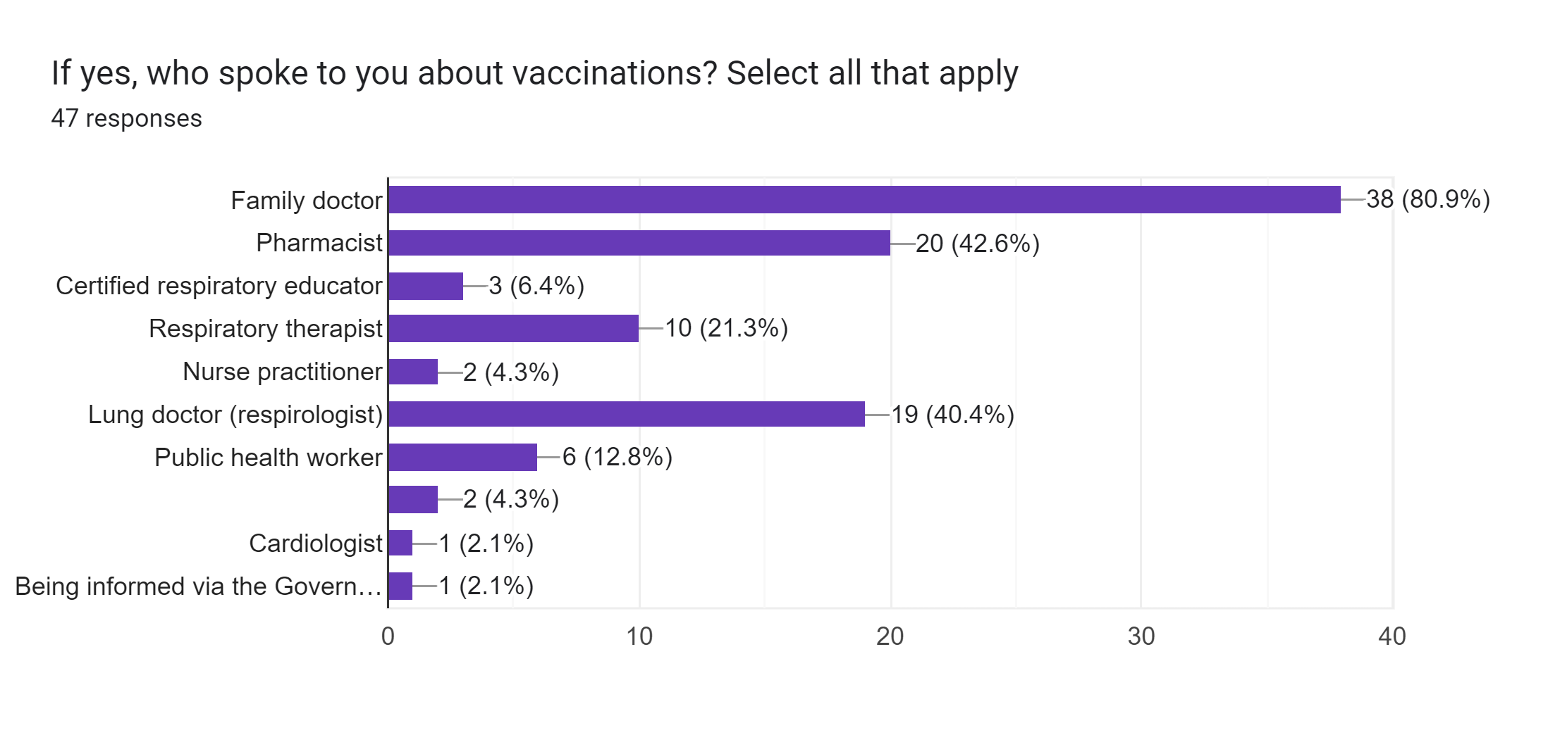

Slide 43
Who keeps track of your immunization status? Please indicate. 76 responses
Self and family doctor
Family doctor/respirologist
I do and my doctor
pharmacy
I keep track of my own status for all shots
Government and I do
There is no tracking
Family doctor & myself
My Chart
I keep track myself
Pharmacy
Me, province
myself.....and doctor
Me, doctor and pharmacist
Me! Plus Wellness co-ordinator here in the residence
I keep track of my covid and flu vaccinations, my family doctor keeps track of
my pneumonia shot
Interior Health
I do with guidance from my daughter who is an RN
I do and I believe my GP does as well
I refuse to listen about vaccines with my lifetime negative experience!
I do - my family doctor does
AB govt, and I have some records
I take care of it myself
I do and my family doctor
Interior Health Authority.
Me. All of my shots have been updated and I keep a record
I do
me
Me
myself
self
Family doctor
Family doctor
No one
I do.
Family Dr and respirologist
Family Doctor
Myself, pharmacist, government website
myself and public health NL
Family Doctor
Myself & Service Ontario.
My Pharmacist & it is in my medical records
I do and Fraser health
I do, and it is in the health bank.
No one
Myself & I assume my doctor
family doctor and myself
I do. The province of BC does as well.
I have not idea
i do
Doctor and i have info on my phone
I do

Slide 44
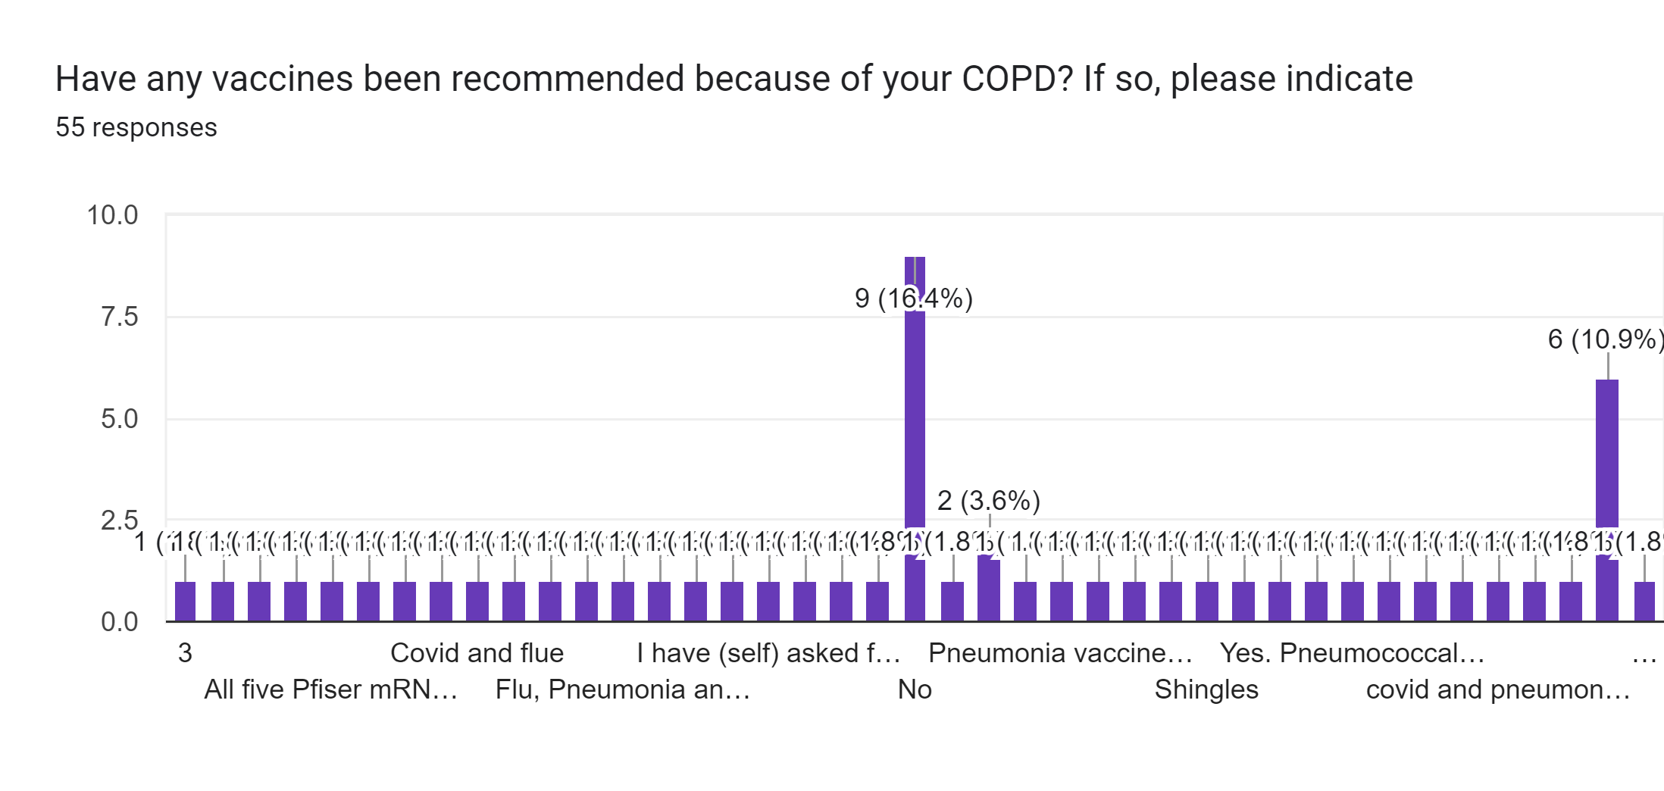

Slide 45
Which vaccines do you seek out on your own? Please indicate 62 responses
Shingles Shot - pneumonia shot other ones recommended by
Health PEI
Whatever is available
Annual flu/ Covid 19
Covid, flu, pneumonia, shingles
Covid & Flu
High dose flu vaccine, COVID-19 vaccines and boosters
I have received all my vaccines
all of them
flu and covid
Flu and any future COVID shots required.
Covid and flu
Covid and flu
Pneumonia
flu shot
I have received five vaccines of Pfizer Brand
COVID, flu, pneumonia
NONE!
Flu and Pneumonia
Covid, shingles
Flu shot
All of them!
covid , flu
Flu, Pneumonia and Covid-19.
High Dose Flu shot
covid shots flu shot
all
Flu
none
None
Shingles
Same
Any that are available
Non
All of them.
covid, flu
No
All 5 COVID vaccines pus a flu shot.
1st 3
None.
Flue and covid
N/a
all that concern my condition
all that are available
None
Flu & pneumonia shot.
Flu tetanus Covid
flu
I make sure I get immunized - family doc and province send reminders
pneumonia shingles
Flu, and COVID-19 vaccinations

Slide 46
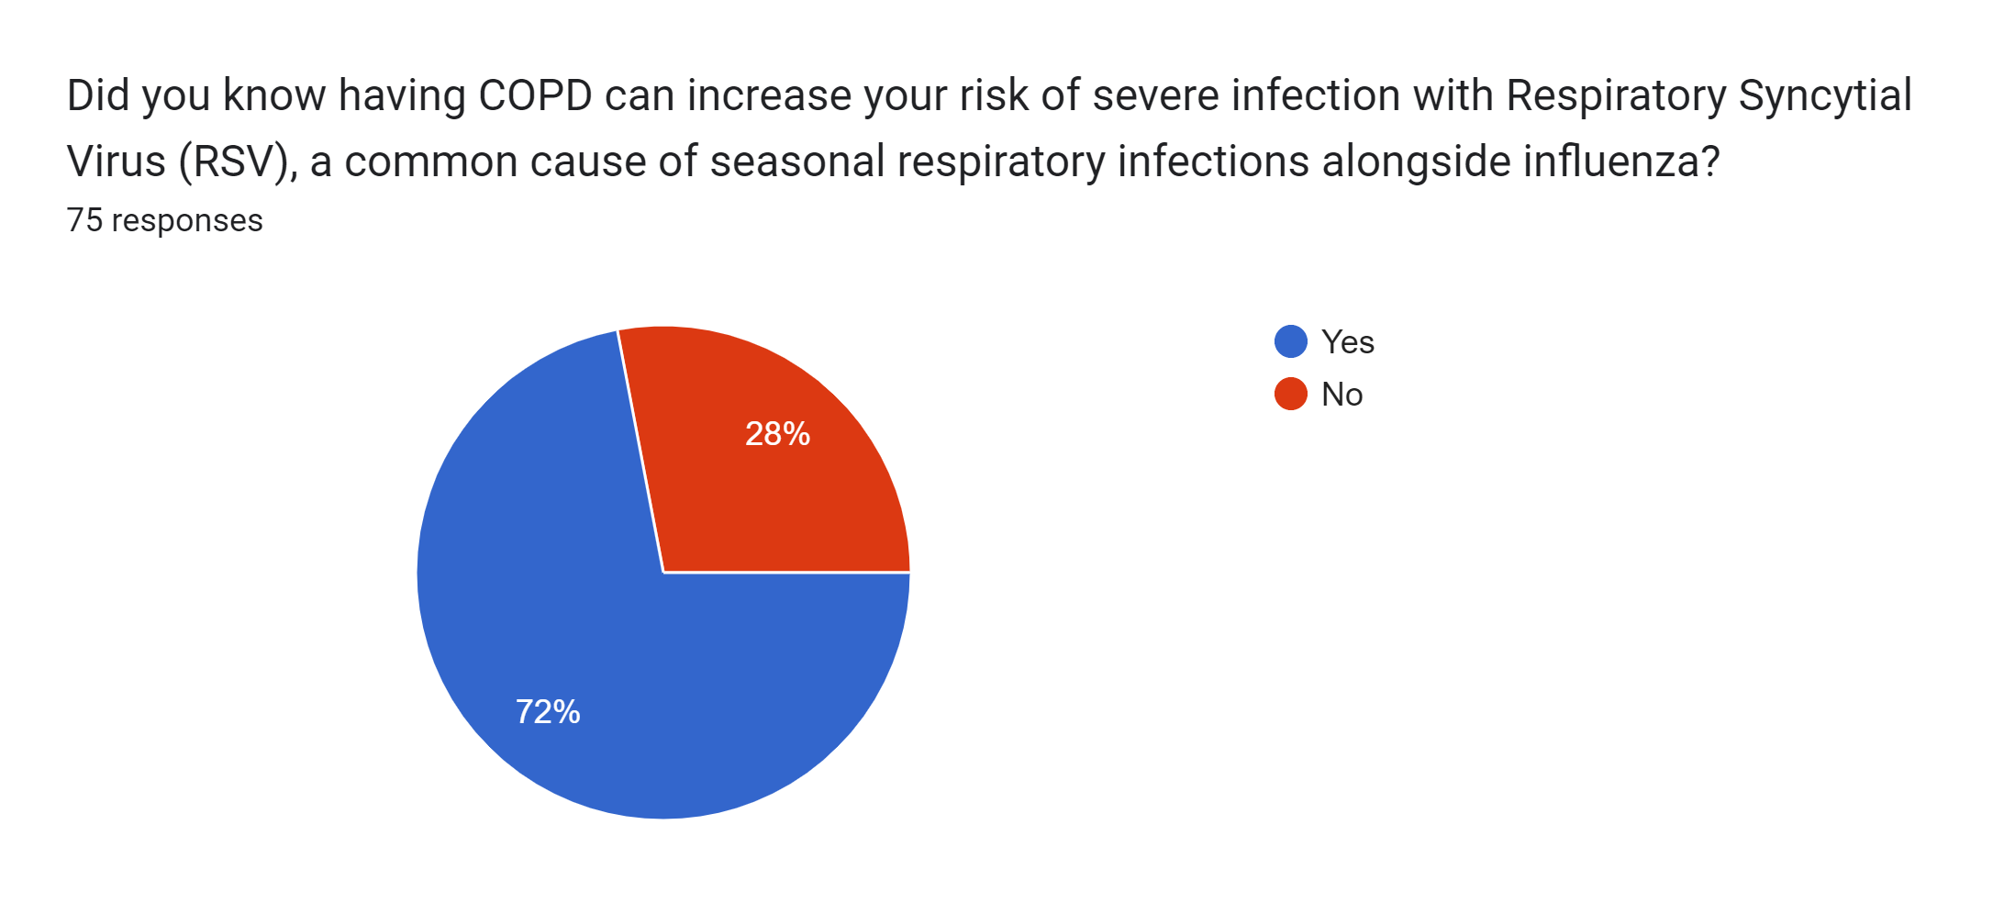

Slide 47
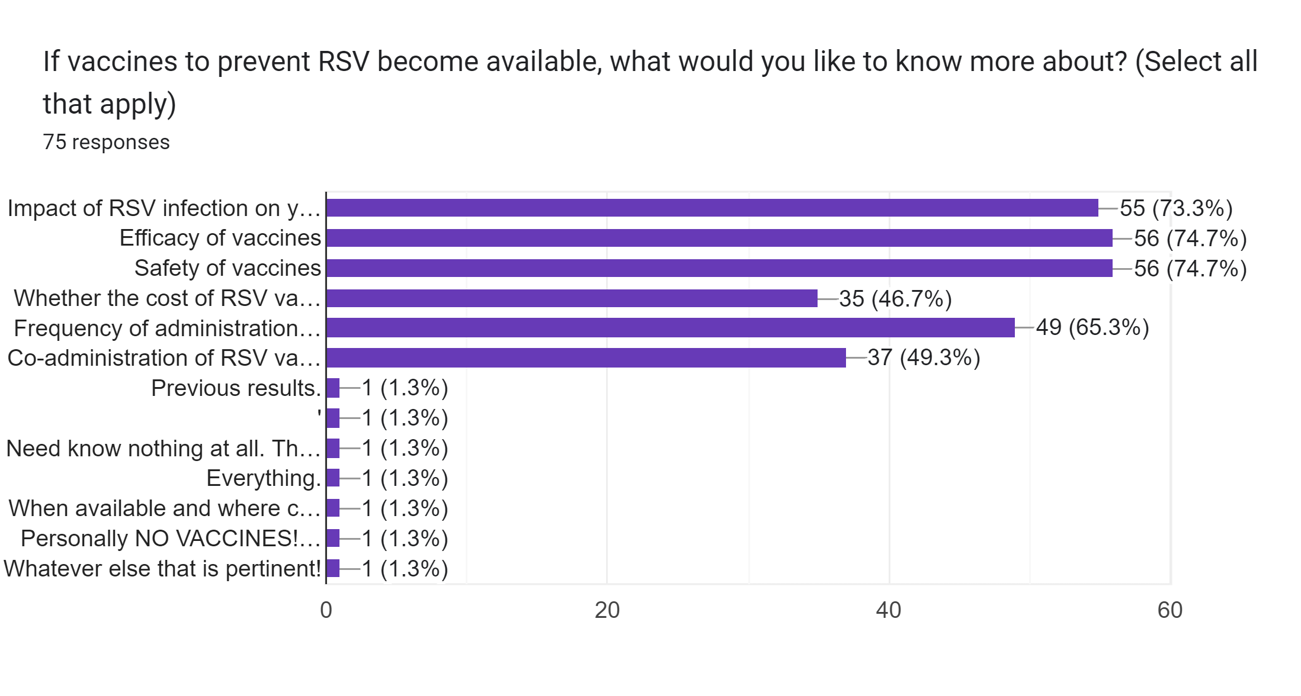

Slide 48
